Slide 1
OPTIMUM III VALUE ADDED RESIDENTIAL SOCIMI S.A. (OVA)
Shareholder’s meeting
June 18th, 2019
© BMB Private & Confidential - www.bmcap.es

Slide 2
SHAREHOLDER’S MEETING - OVA
AGENDA
1 Censura de la gestión social, examen y aprobación, en su caso, de las cuentas anuales y del informe de gestión de la Sociedad, así como de la propuesta de aplicación del resultado, todos ellos correspondientes al ejercicio social cerrado a 31 de diciembre de 2018.
2 Delegación de facultades.
3 Lectura y aprobación, en su caso, del acta.
AGENDA
1 Approval of the corporate management, study and approval of the annual accounts and the management report as well as the propose of the application of profits and distribution of dividends for the fiscal year 2018 ended 31 December 2018 .
2 Delegation of powers.
3 Reading and approval, as the case may be, of the minutes.

Slide 3
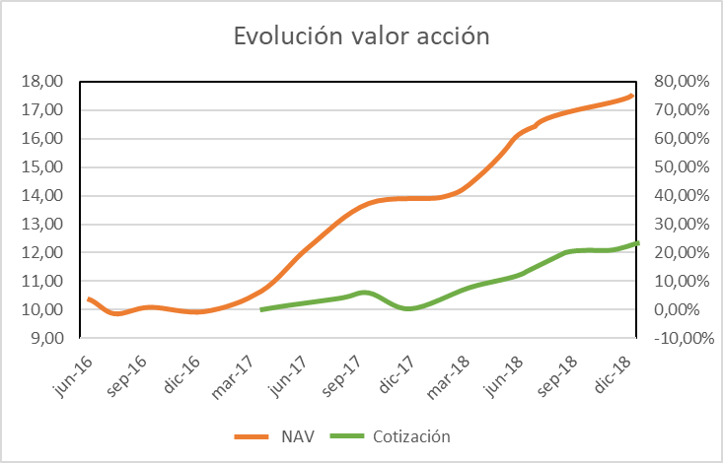
NAV CALCULATION December 31st, 2018- OVA

Slide 4

PORTFOLIO
FINANCIAL
STATEMENTS

Slide 5
ACCOUNTS AS OF DECEMBER 18 (BALANCE SHEET) - OVA

Slide 6
ACCOUNTS AS OF DECEMBER 18 (P&L) - OVA

Slide 7
OVA
THE END
Optimum RE Spain, SOCIMI Private & Confidential

